Slide 1
COVID Ordering and Administration

Slide 2
Two Methods
Mass Vaccination Module
Normal Clinic Workflow

Slide 3
Mass Vaccination Module
Patient arrives
Station 1: Patient Check-In/Ordering/Patient Identification Sheet
Station 2: Nurse/Tech conducts Screening Form
Station 3: BCMA
Station 4: Checkout

Slide 4
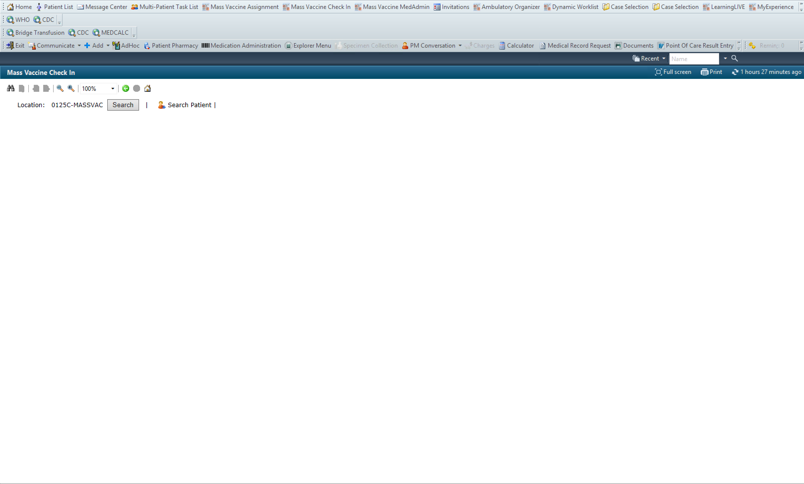
Mass Vaccination Module
1.
Open Mass Vaccine Check In
Search for Mass Vacc Clinic
Search Patient
2.
3.

Slide 5
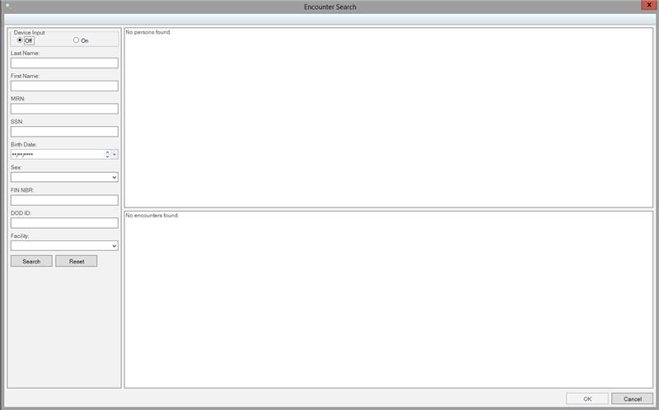
Patient Search
If using a Scanner to read the ID Card – Device Input = On
Enter Patient Information to search
1.
2.

Slide 6
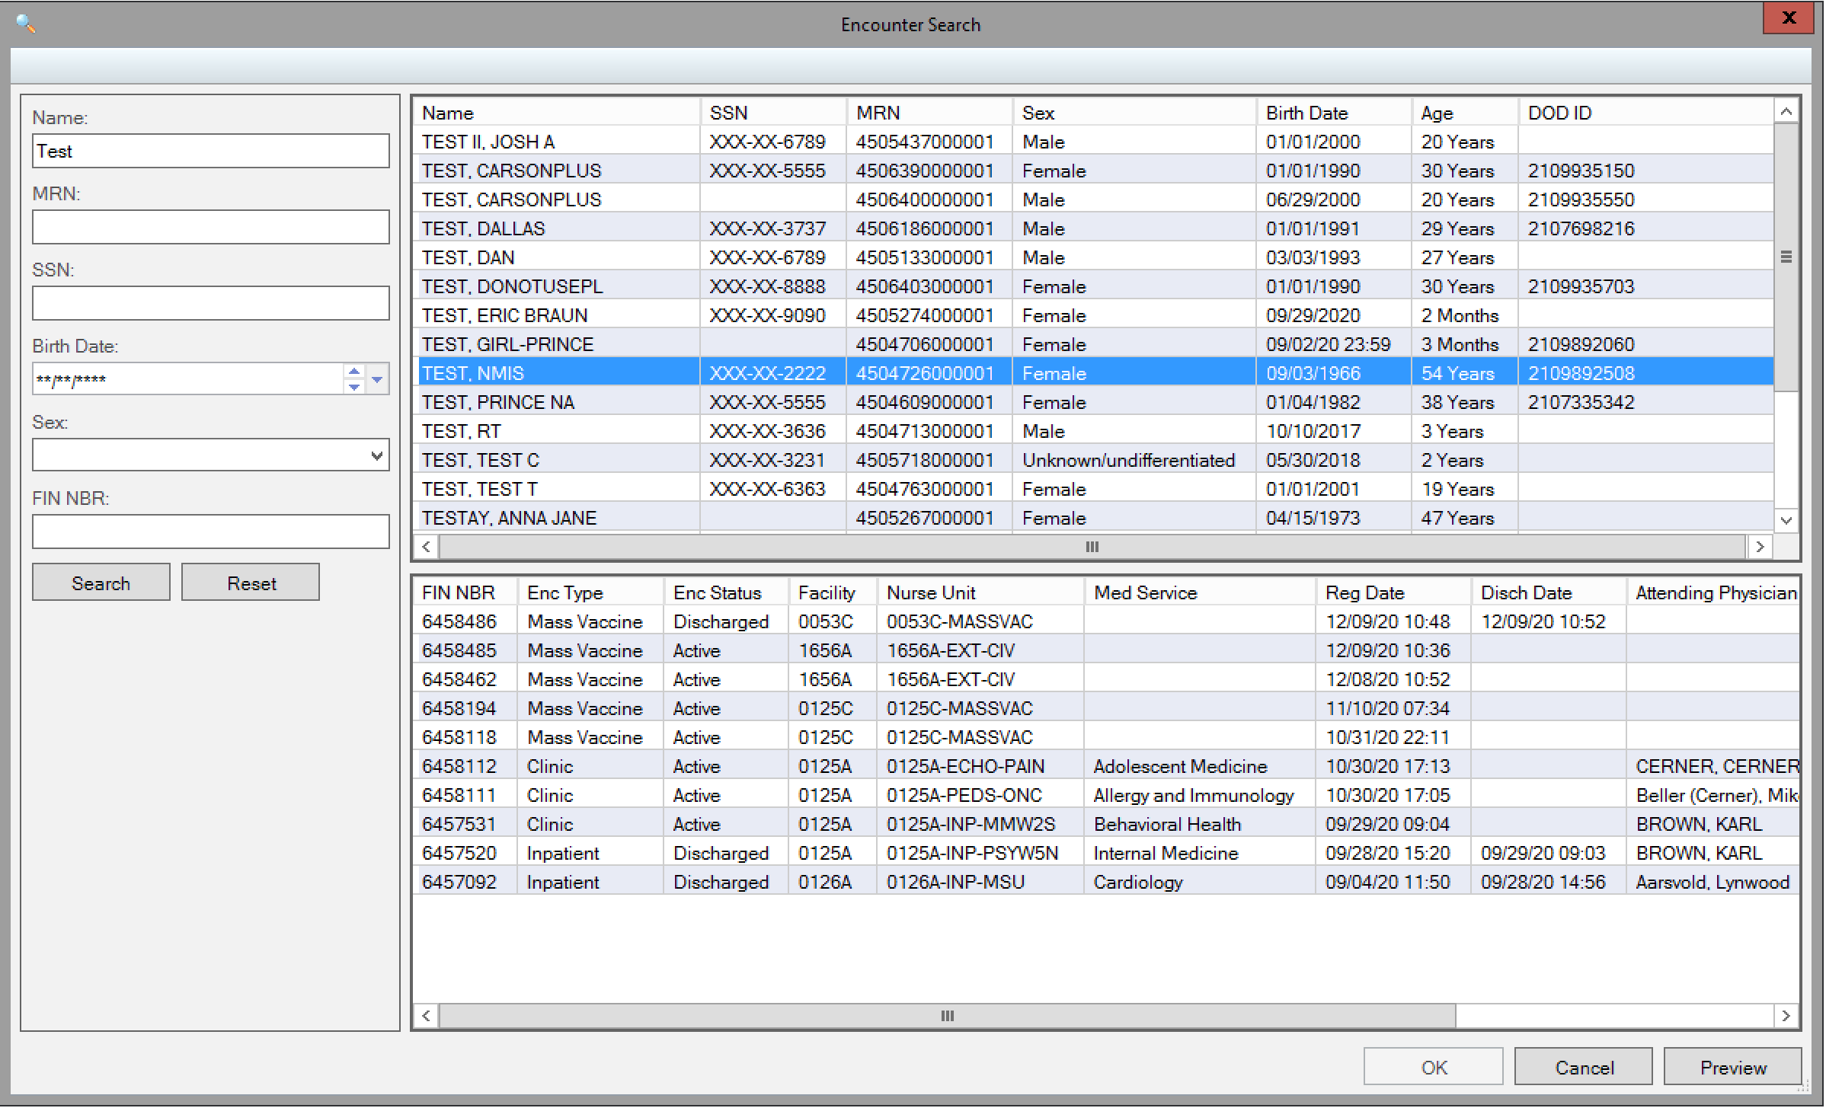
1. Select Any Encounter
1.

Slide 7
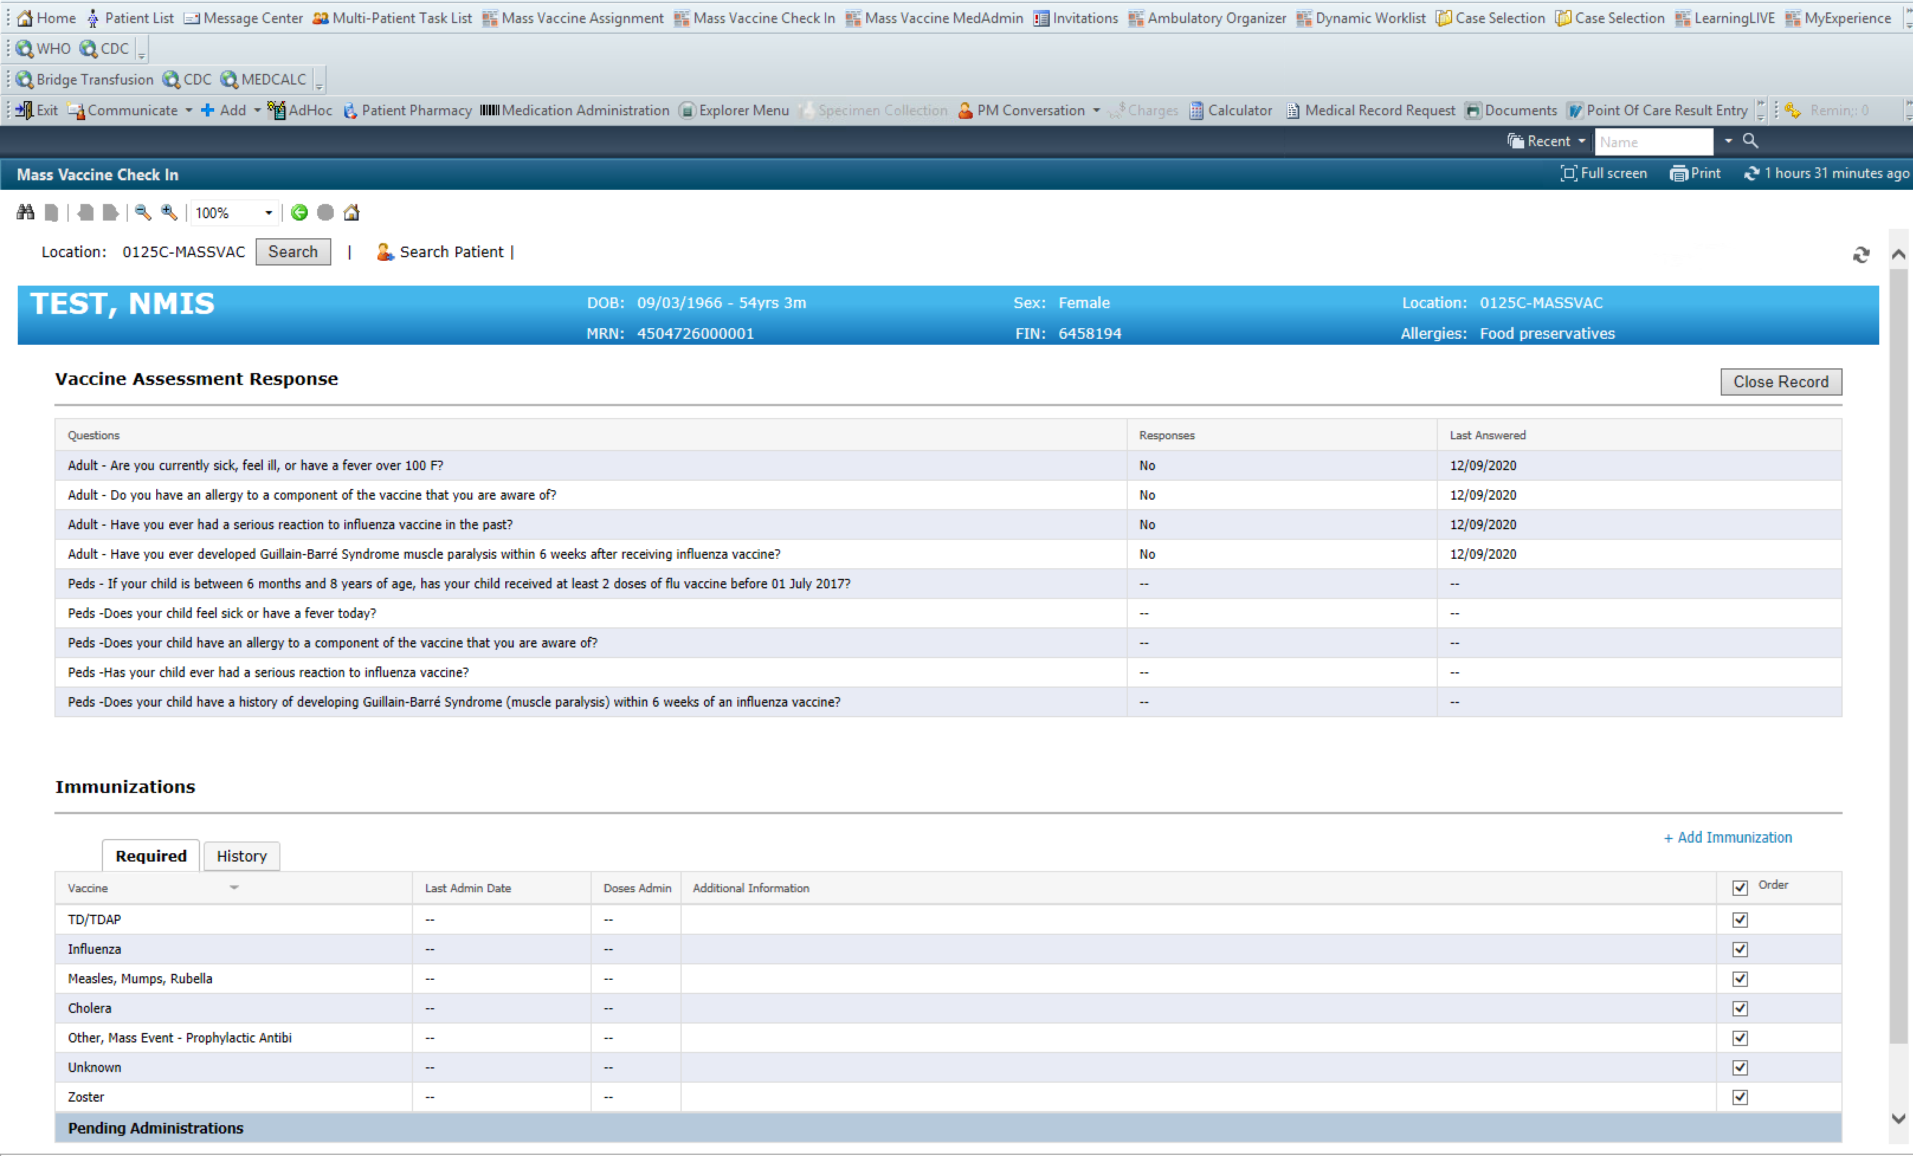
Mass Vaccination Module
1. Select + Add Immunizations if COVID is not found in Required
1.

Slide 8
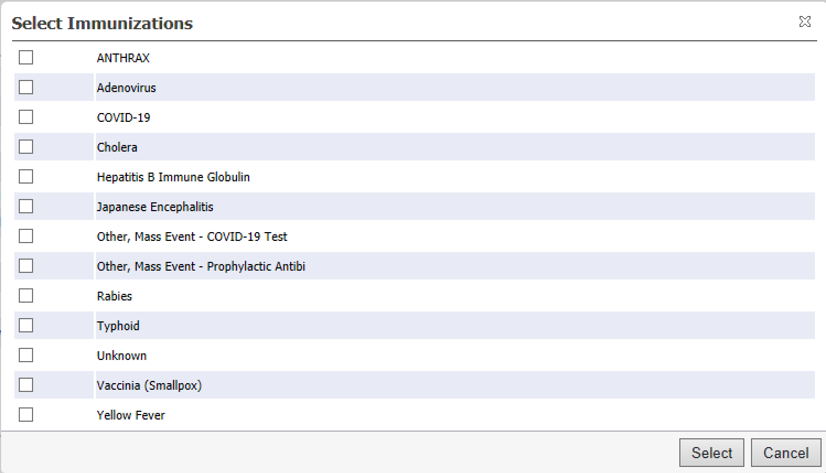
Add COVID Vacc to Patient
Select COVID-19
Hit Select
***MASS EVENT IS FOR COVID TESTING***
1.
2.

Slide 9
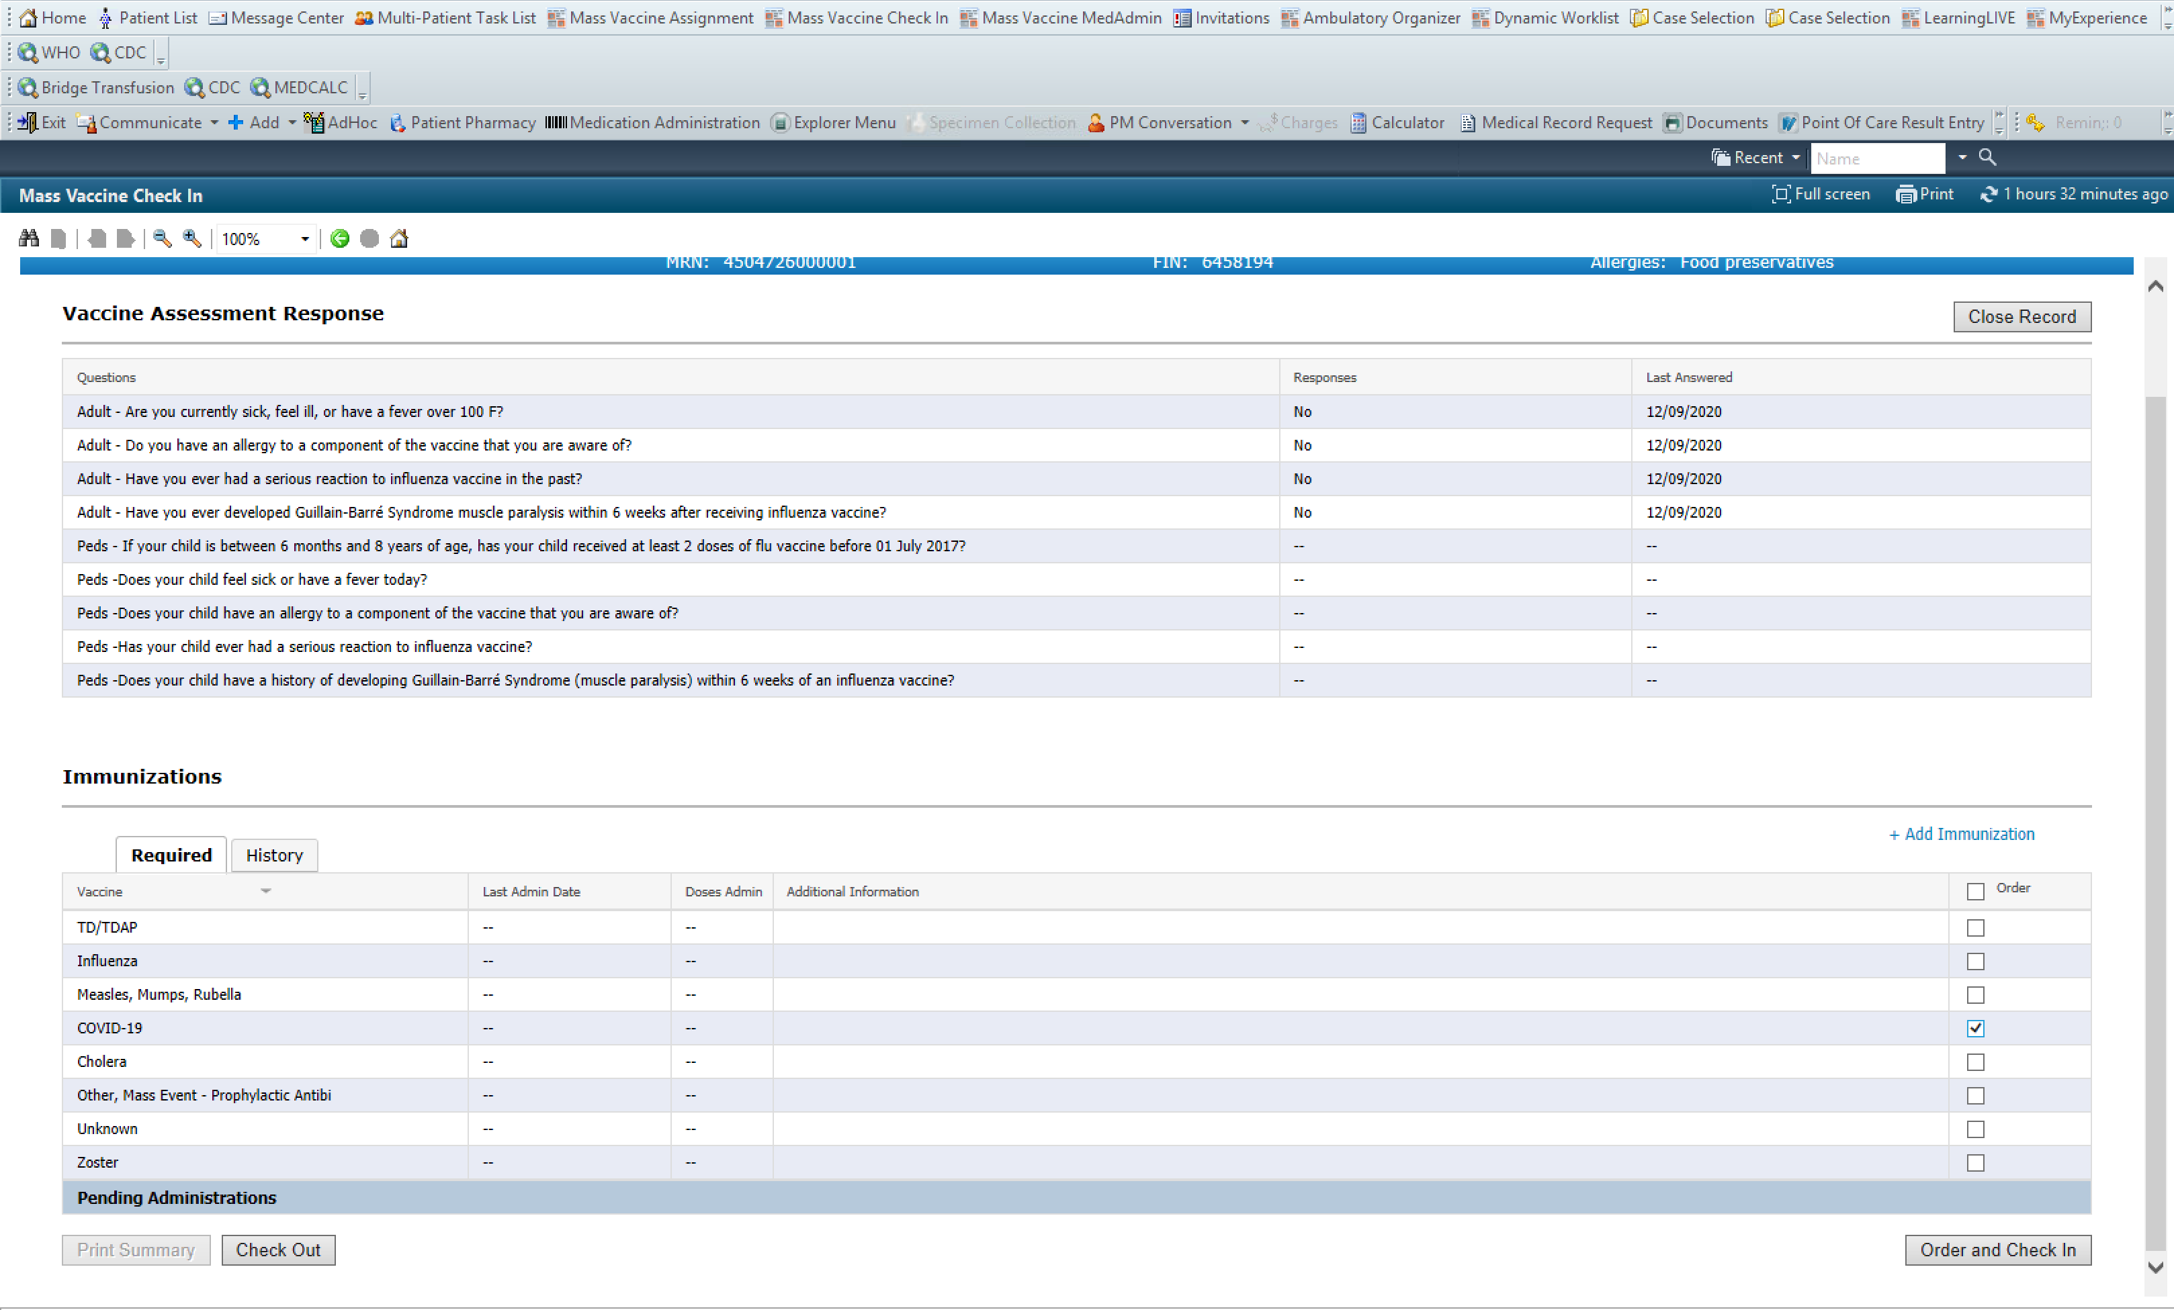
Order & Check In
Select the box next to order, it will select all, then uncheck all
Select COVID-19
Select Order and Check In
1.
2
3.

Slide 10
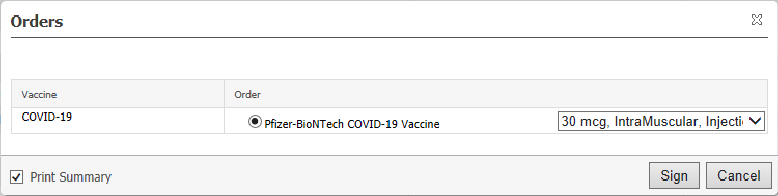
Select the Order Sentence
2.
1.
Check Print Summary
Sign

Slide 11
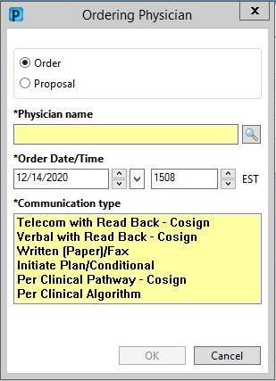
Non-Provider Ordering
Use “Order” (Proposal cannot be acted on until the provider signs the order)
If you have a signed directive/protocol, use “Per Clinical Algorithm”
-If you do not have a signed directive/protocol use “Per Clinical Pathway – Cosign” (This will be able to be acted on but the provider will still need to sign)
1.
2.

Slide 12
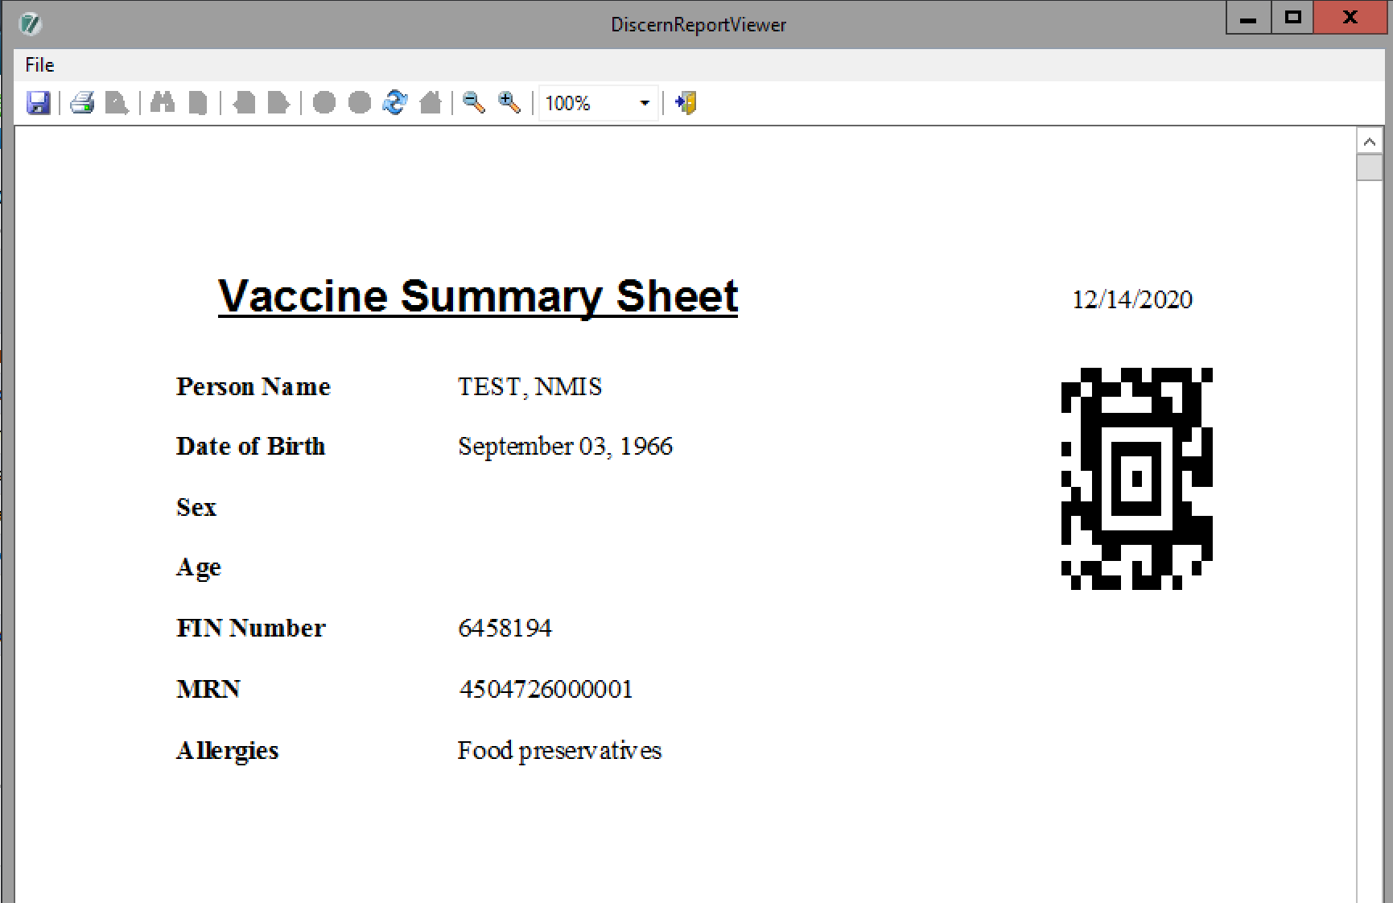
Print Summary Sheet
Print the Document
This will use the Computer’s default printer, configured before starting
1.

Slide 13
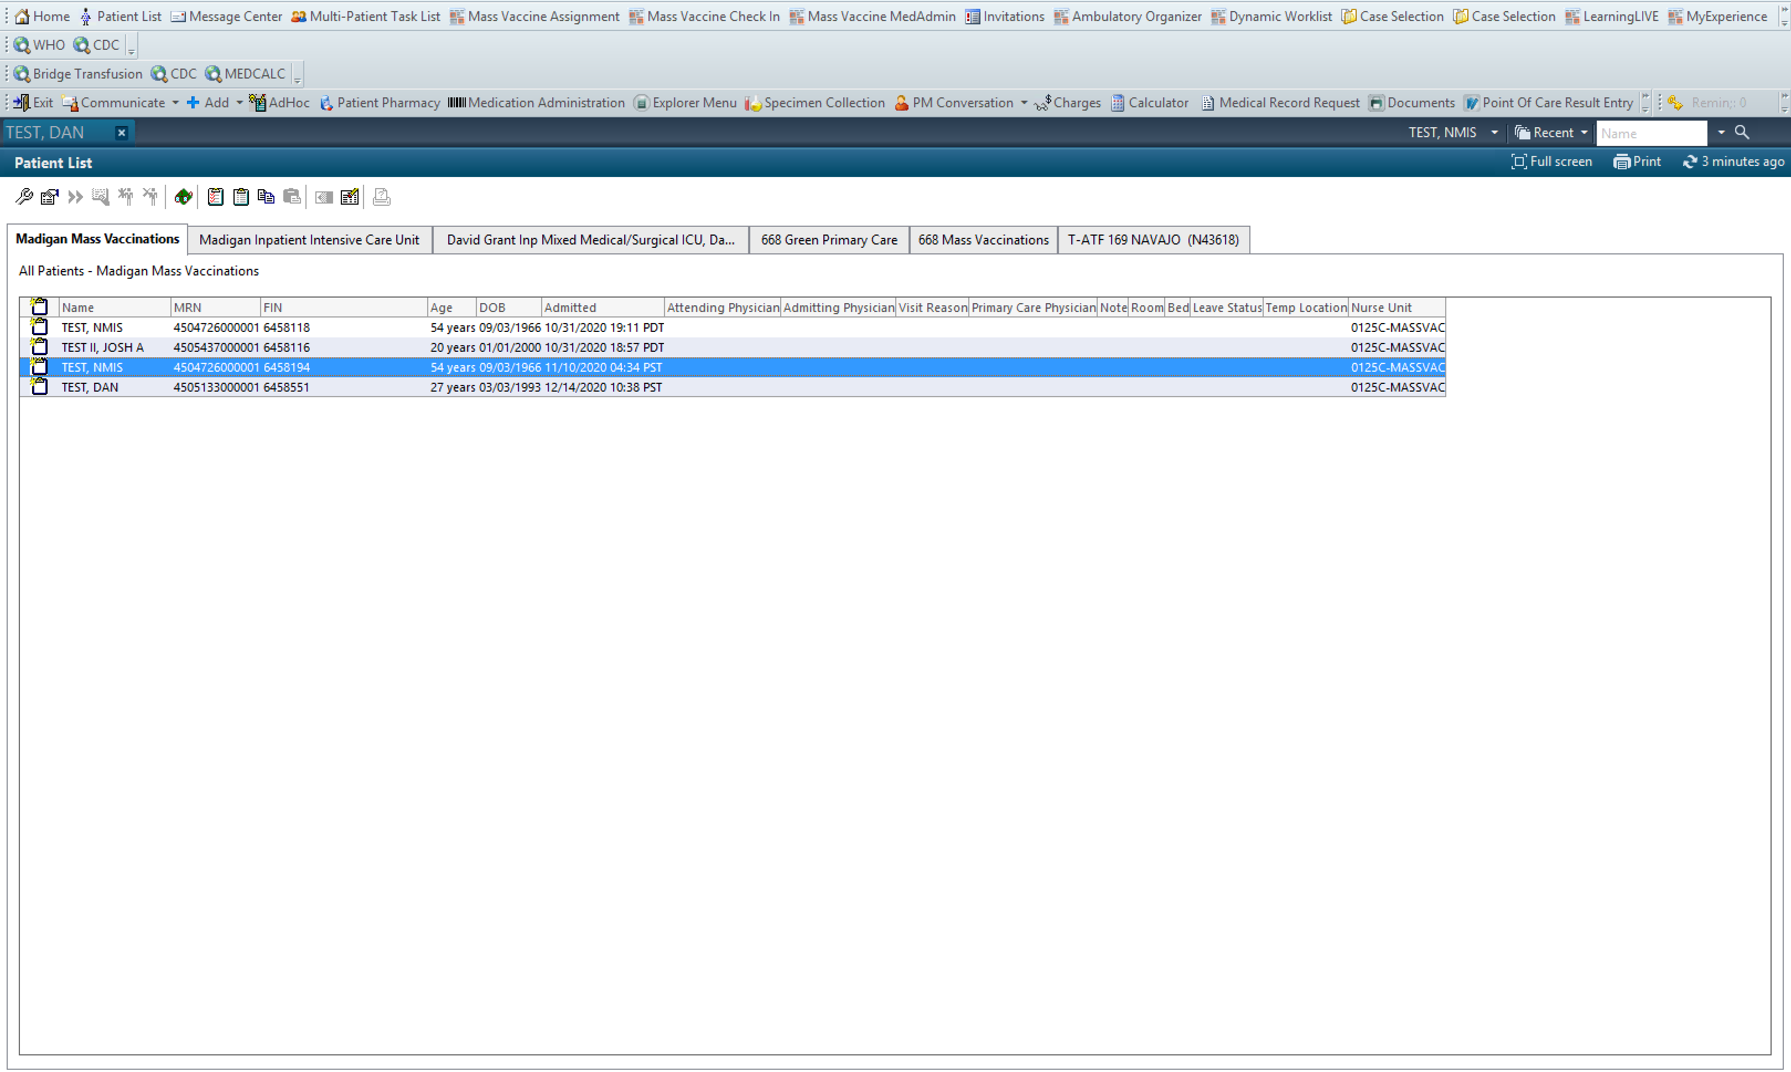
Screen the Patient
1.
Select “Patient List”
Select the correct patient to open the chart
2.

Slide 14
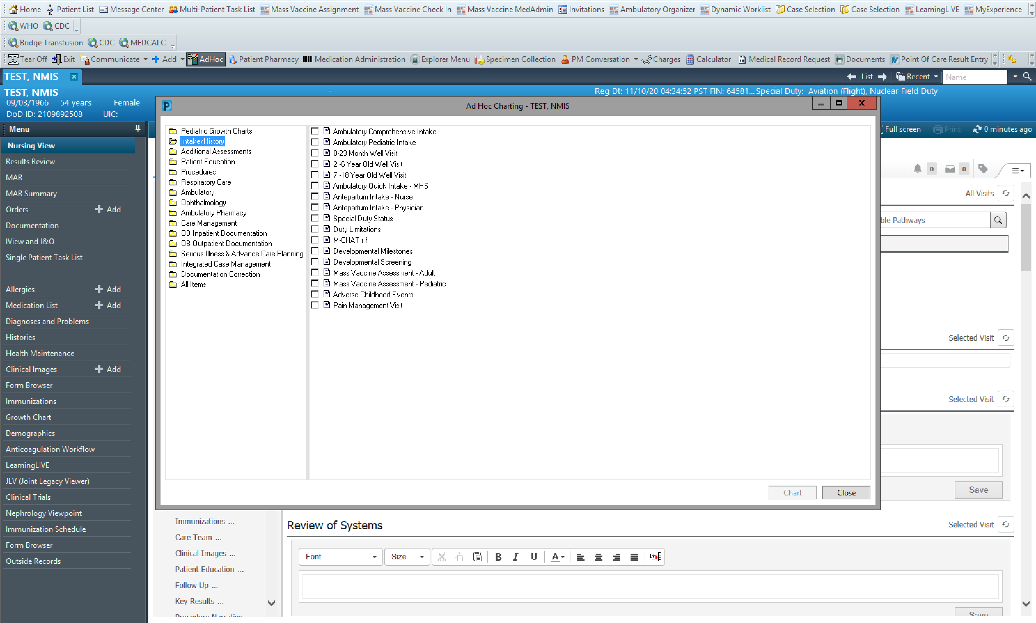
Screen the Patient
1.
Select Ad Hoc
Intake/History Folder
Mass Vaccine Assessment-Adult
2.
3.

Slide 15
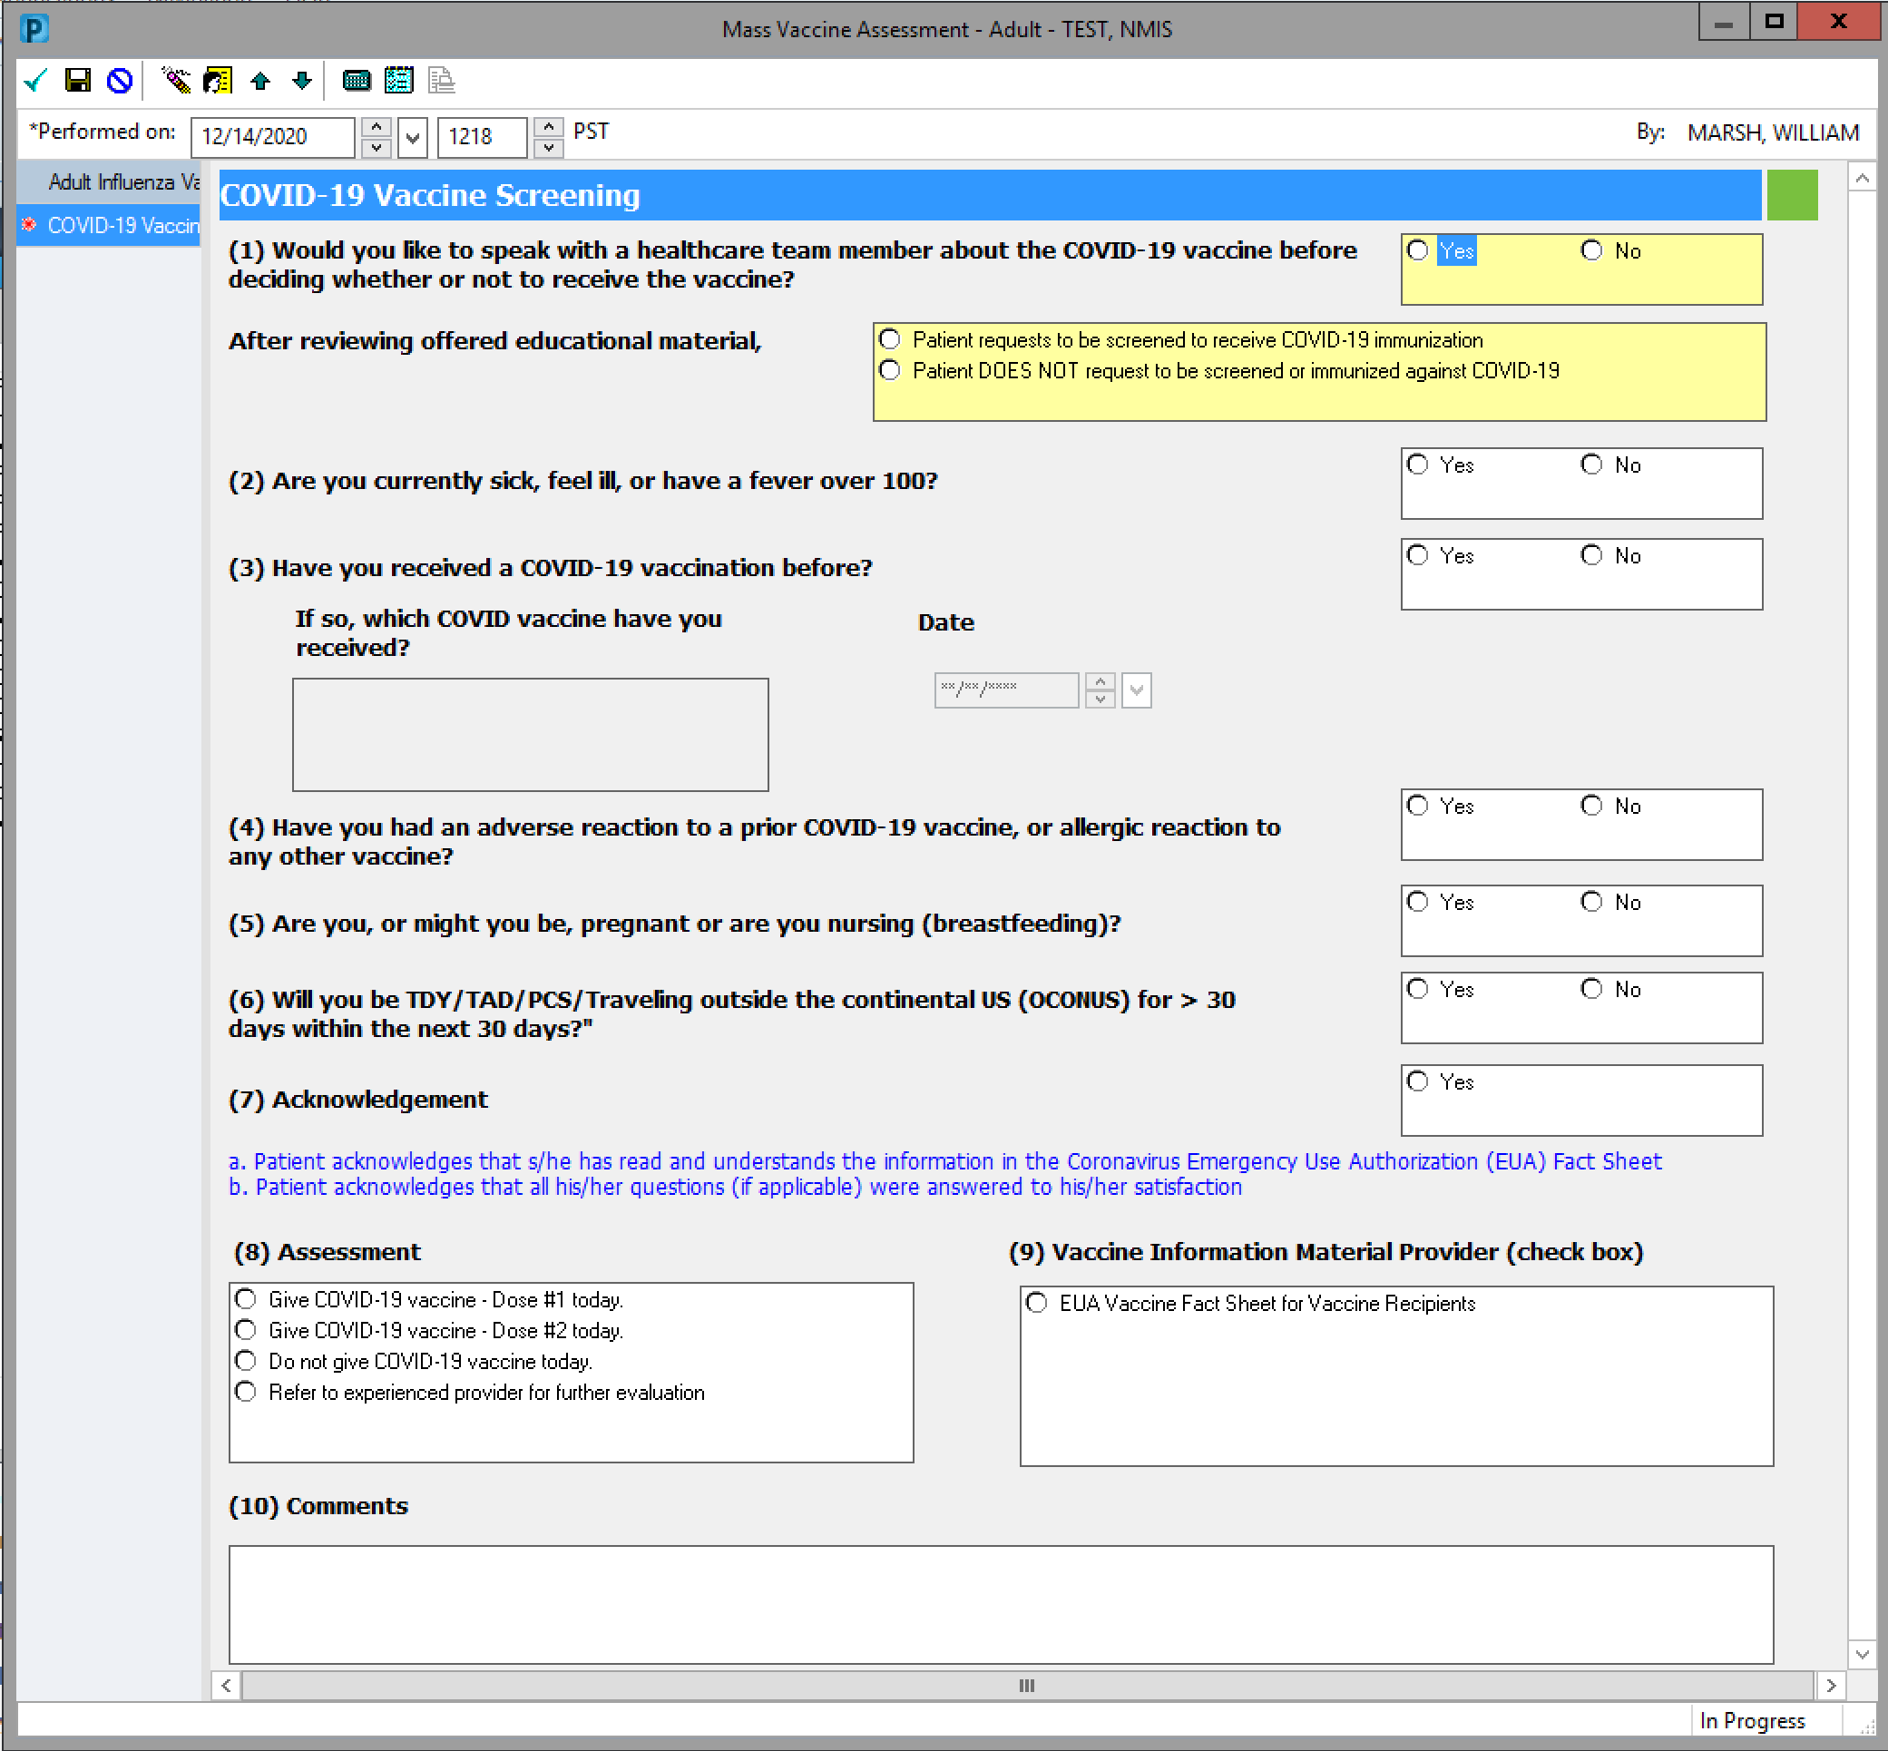
Screen the Patient
2.
Answer all yellow (Required) fields & Complete the form
Select the green check
1.

Slide 16
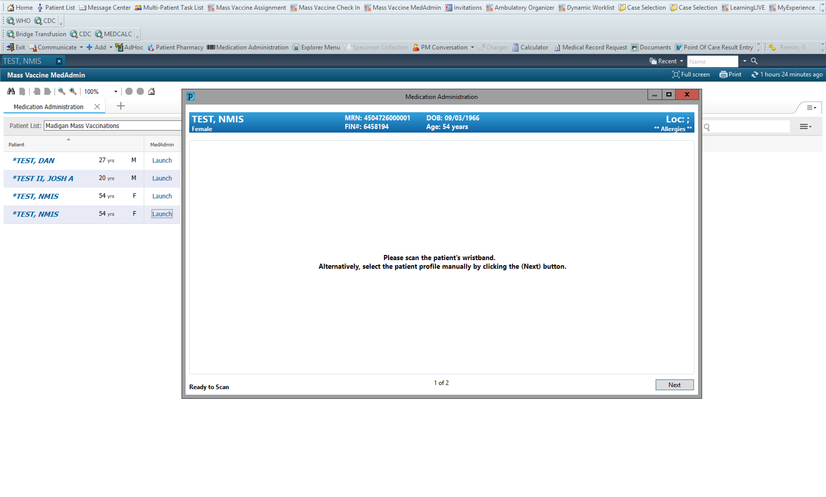
Mass Vaccine MedAdmin
1.
2.
3.
4.
Select Mass Vaccine MedAdmin
Select the appropriate patient list
Click Launch
Scan Paper

Slide 17
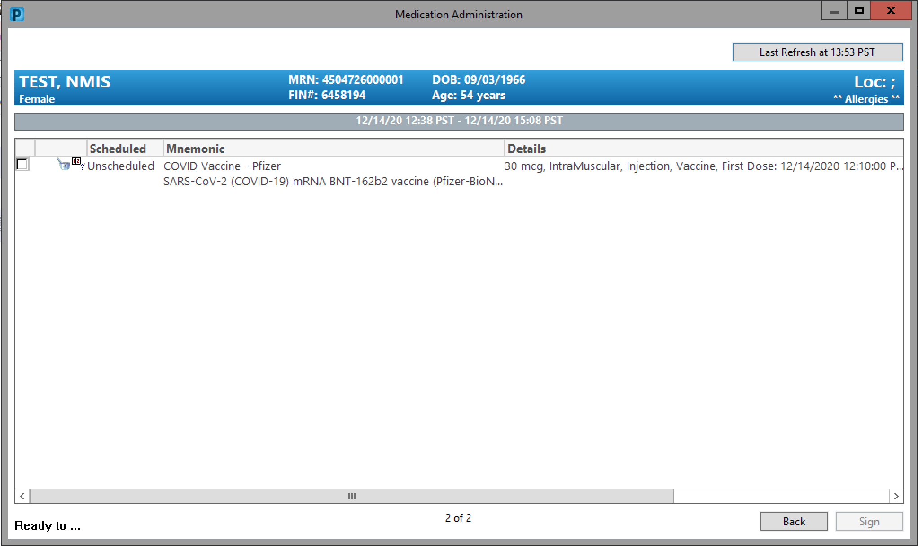
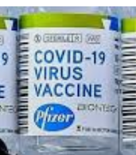
BCMA
1.
1. Scan Product Barcode

Slide 18
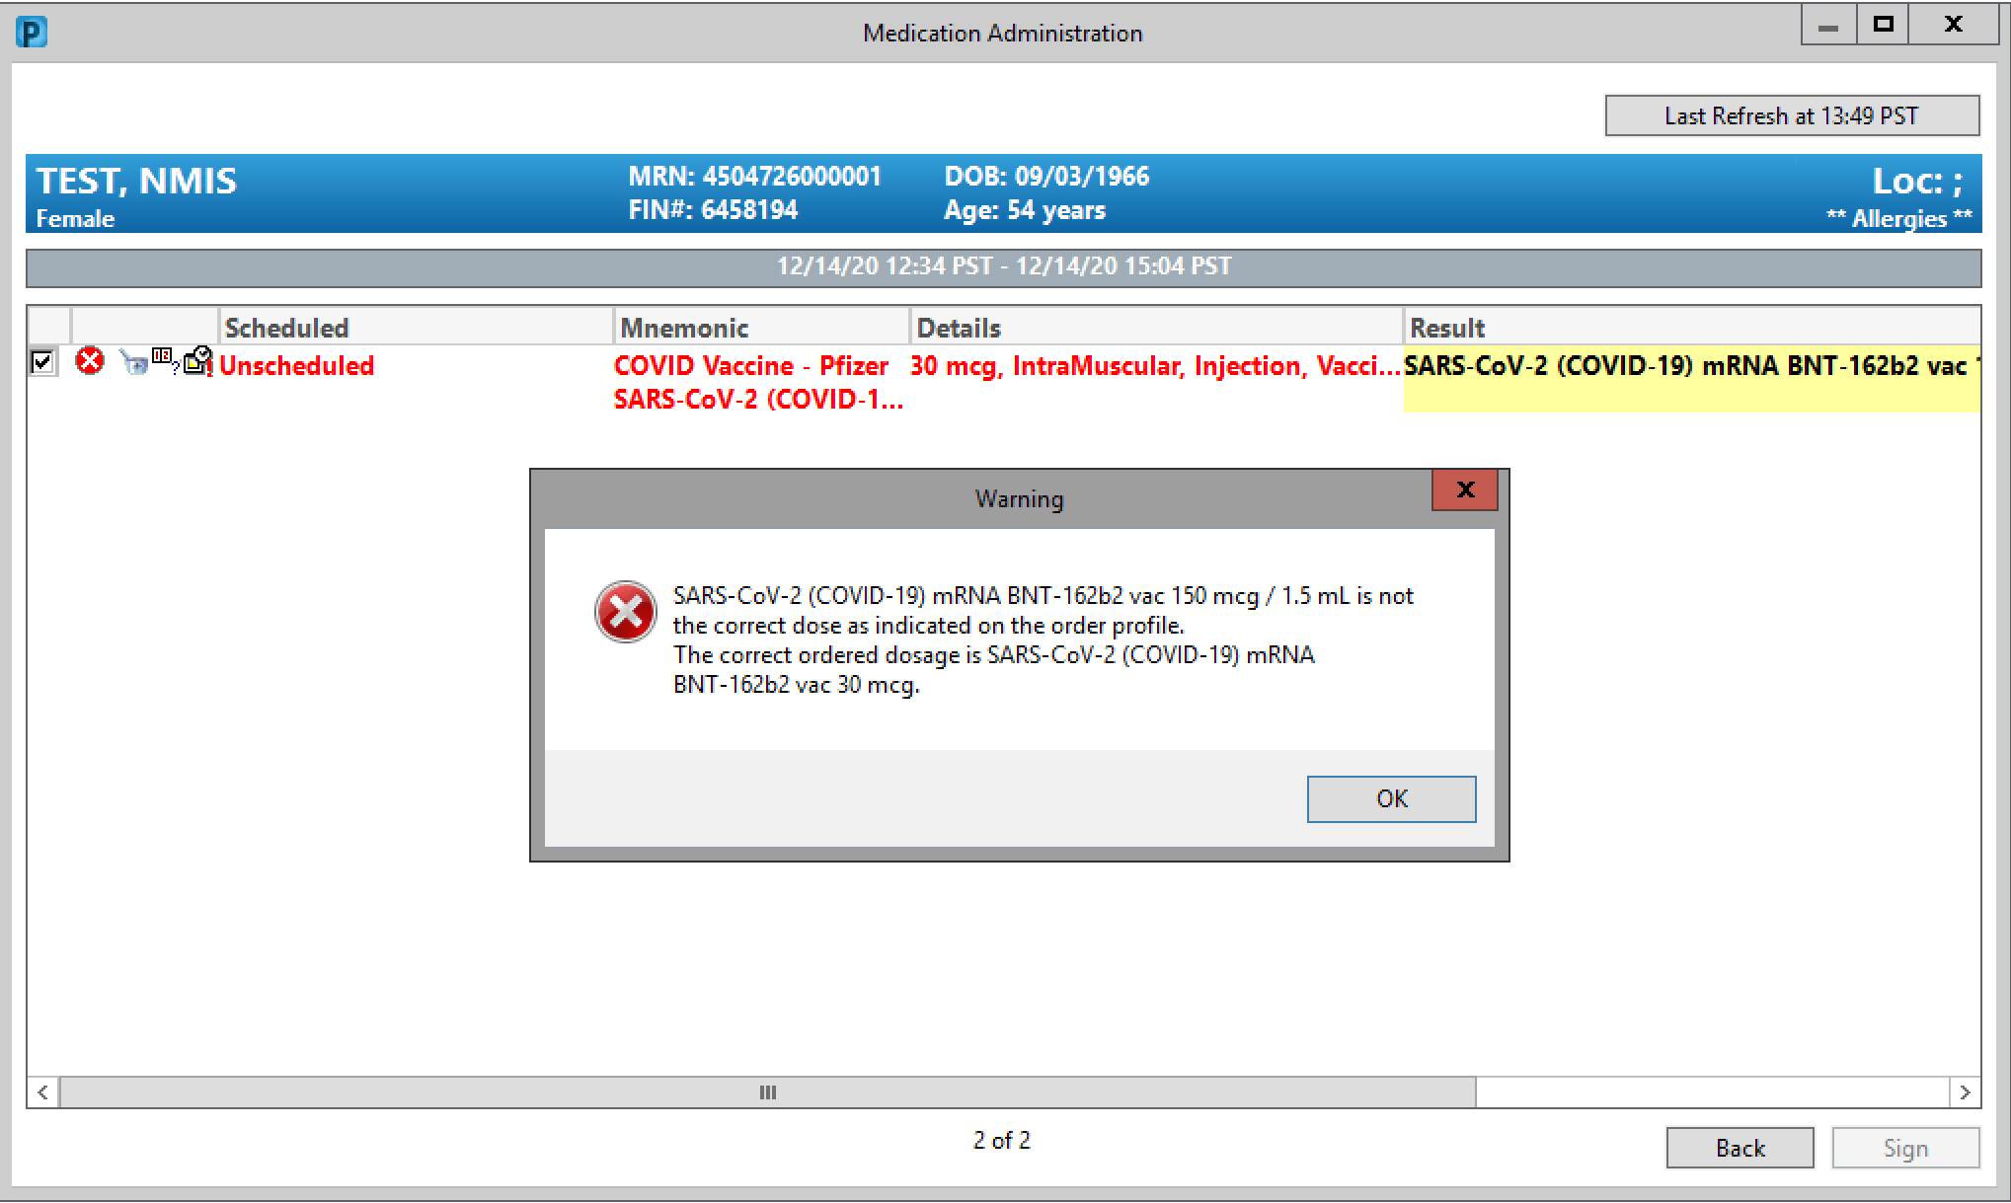
BCMA - MDV
These are being distributed as Multi-Dose Vials (MDV). What you scan is OVER the amount to be administered – You must tell the system how much you are giving.
1. Acknowledge warning
1.

Slide 19
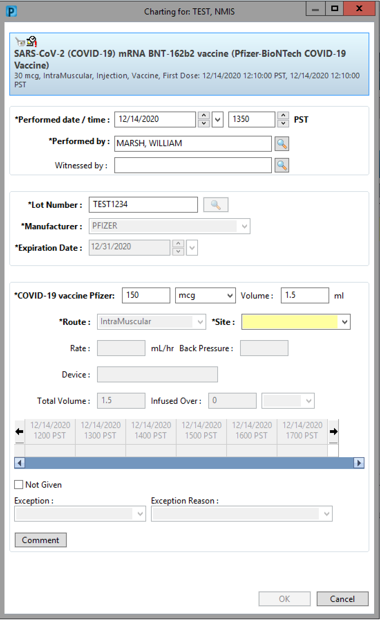
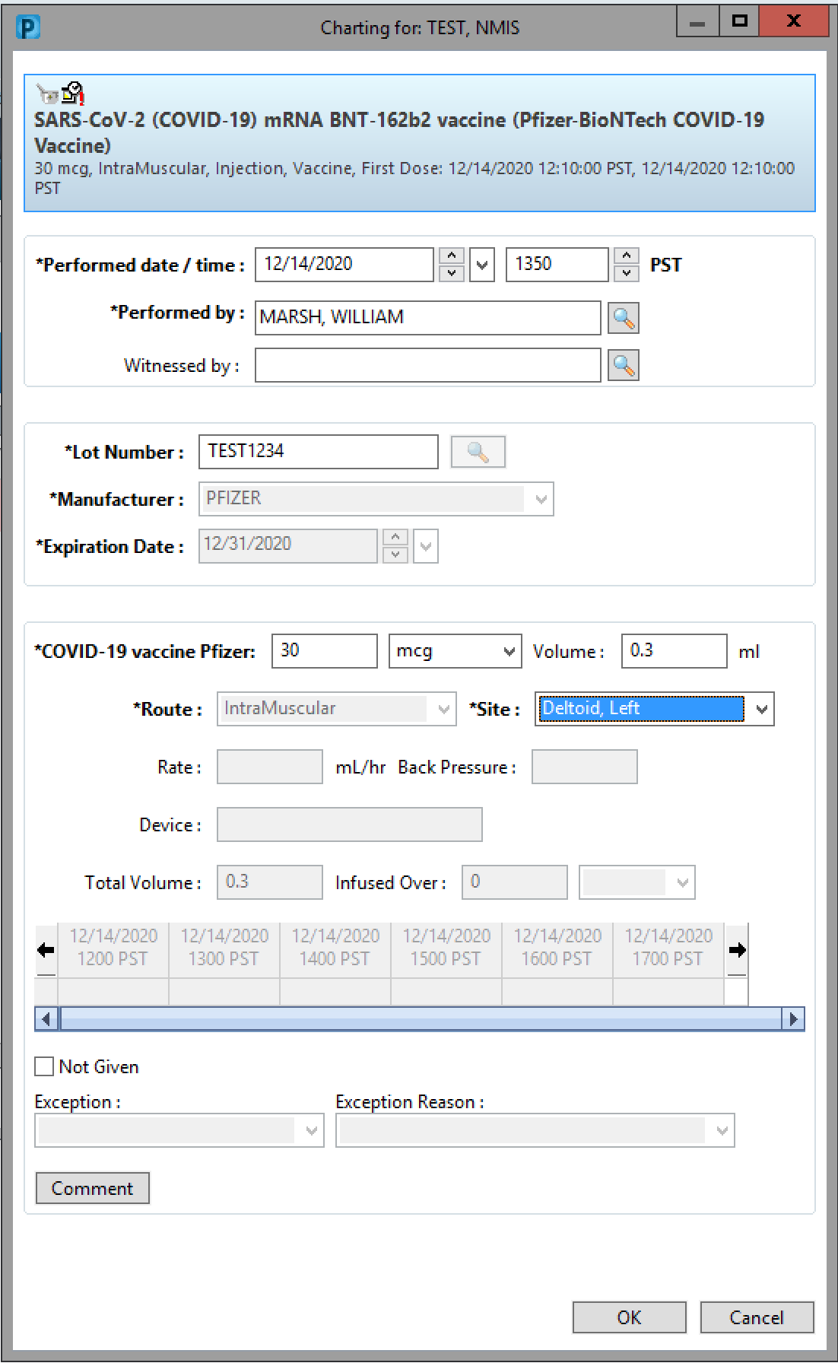
BCMA - MDV
If more than one lot is loaded in the location’s inventory, the magnifying glass will display which ones are available – Select one.
Update admin dose (30mcg)
Specify Site
OK
If Patient declines at this point, check “Not Given” and provide reasons
1.
Update
2.
3.

Slide 20
Check out
1.
Open Mass Vaccine Check In
Search for Mass Vacc Clinic
Search Patient
2.
3.

Slide 21
Patient Search
If using a Scanner to read the ID Card – Device Input = On
Enter FIN from The Vaccination Summary Sheet
1.
2.

Slide 22
1. Select Any Encounter
1.

Slide 23
Check Out
1. Select Check Out
1.

Slide 24
Clinic Workflow

Slide 25
Clinic Workflow
Patient will have a clinic appointment
Clerk checks patient in
Nurse/Tech conducts intake
Nurse Orders Per Clinical Algorithm
Nurse conducts Bar Code Medication Administration
Nurse Completes nurse only visit note
Patient’s encounter is discharged at midnight.

Slide 26
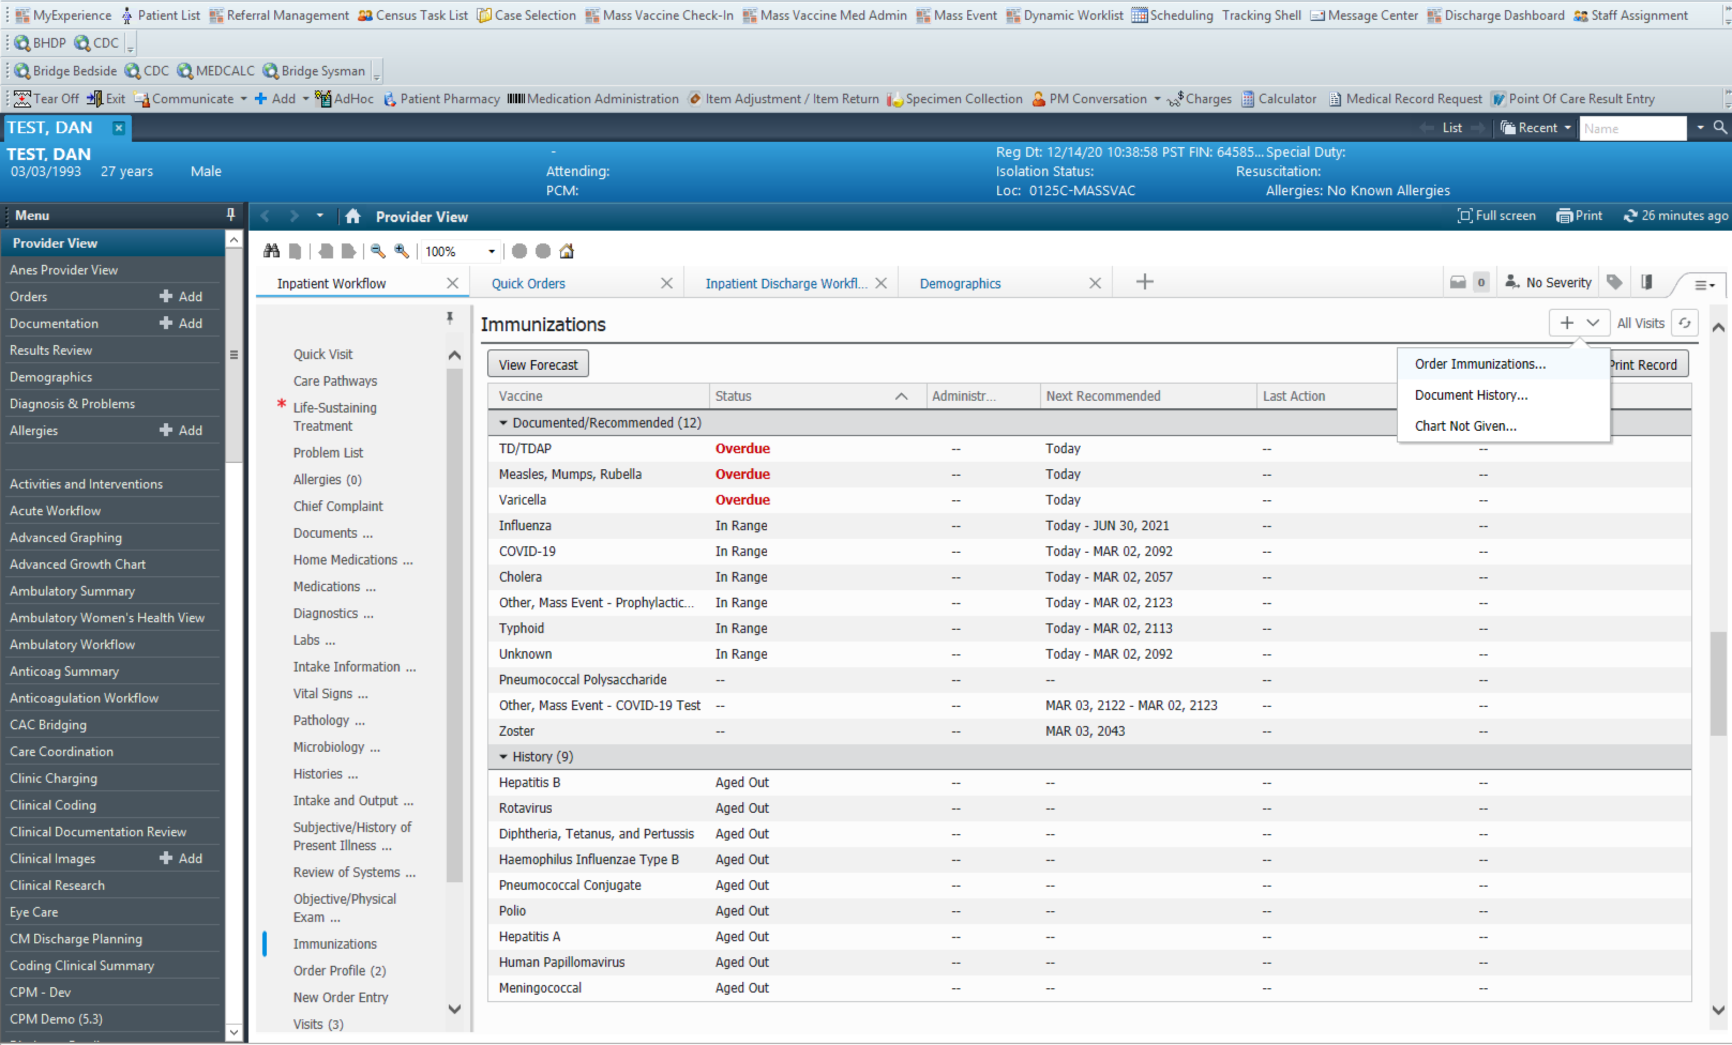
1.
1.

Slide 27
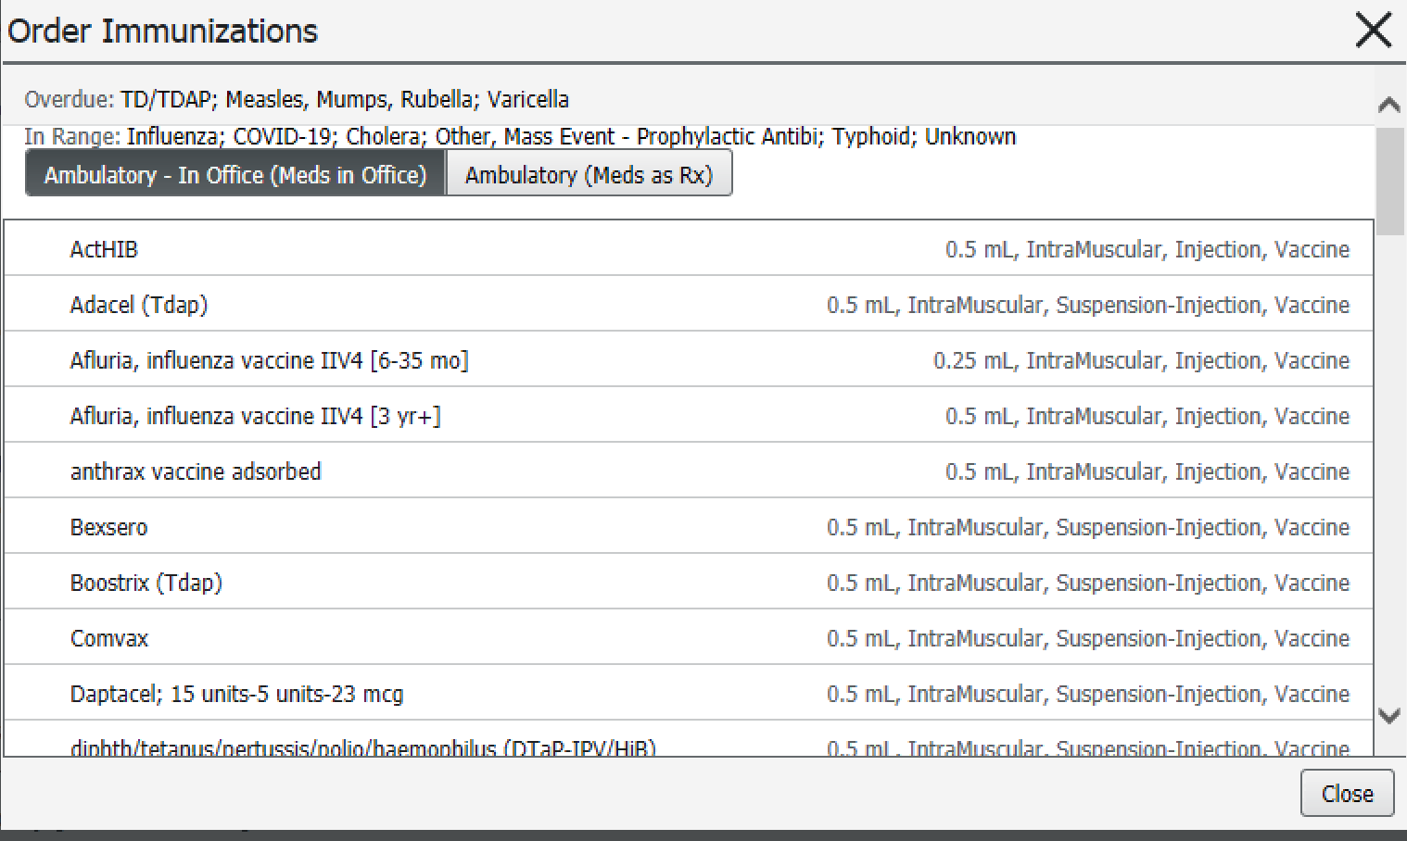
Select Ambulatory – In Office Meds
Scroll down to Pfizer
1.
2.

Slide 28
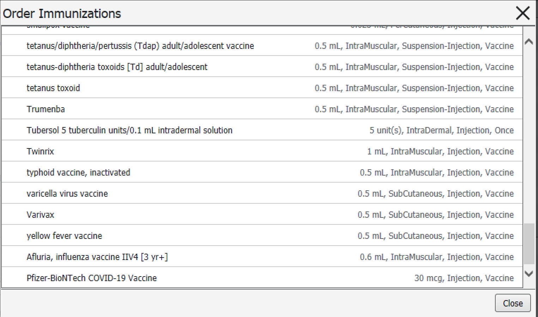
Click the order
1.

Slide 29
Non-Provider Ordering
Use “Order” (Proposal cannot be acted on until the provider signs the order)
If you have a signed directive/protocol, use “Per Clinical Algorithm”
-If you do not have a signed directive/protocol use “Per Clinical Pathway – Cosign” (This will be able to be acted on but the provider will still need to sign)
1.
2.

Slide 30
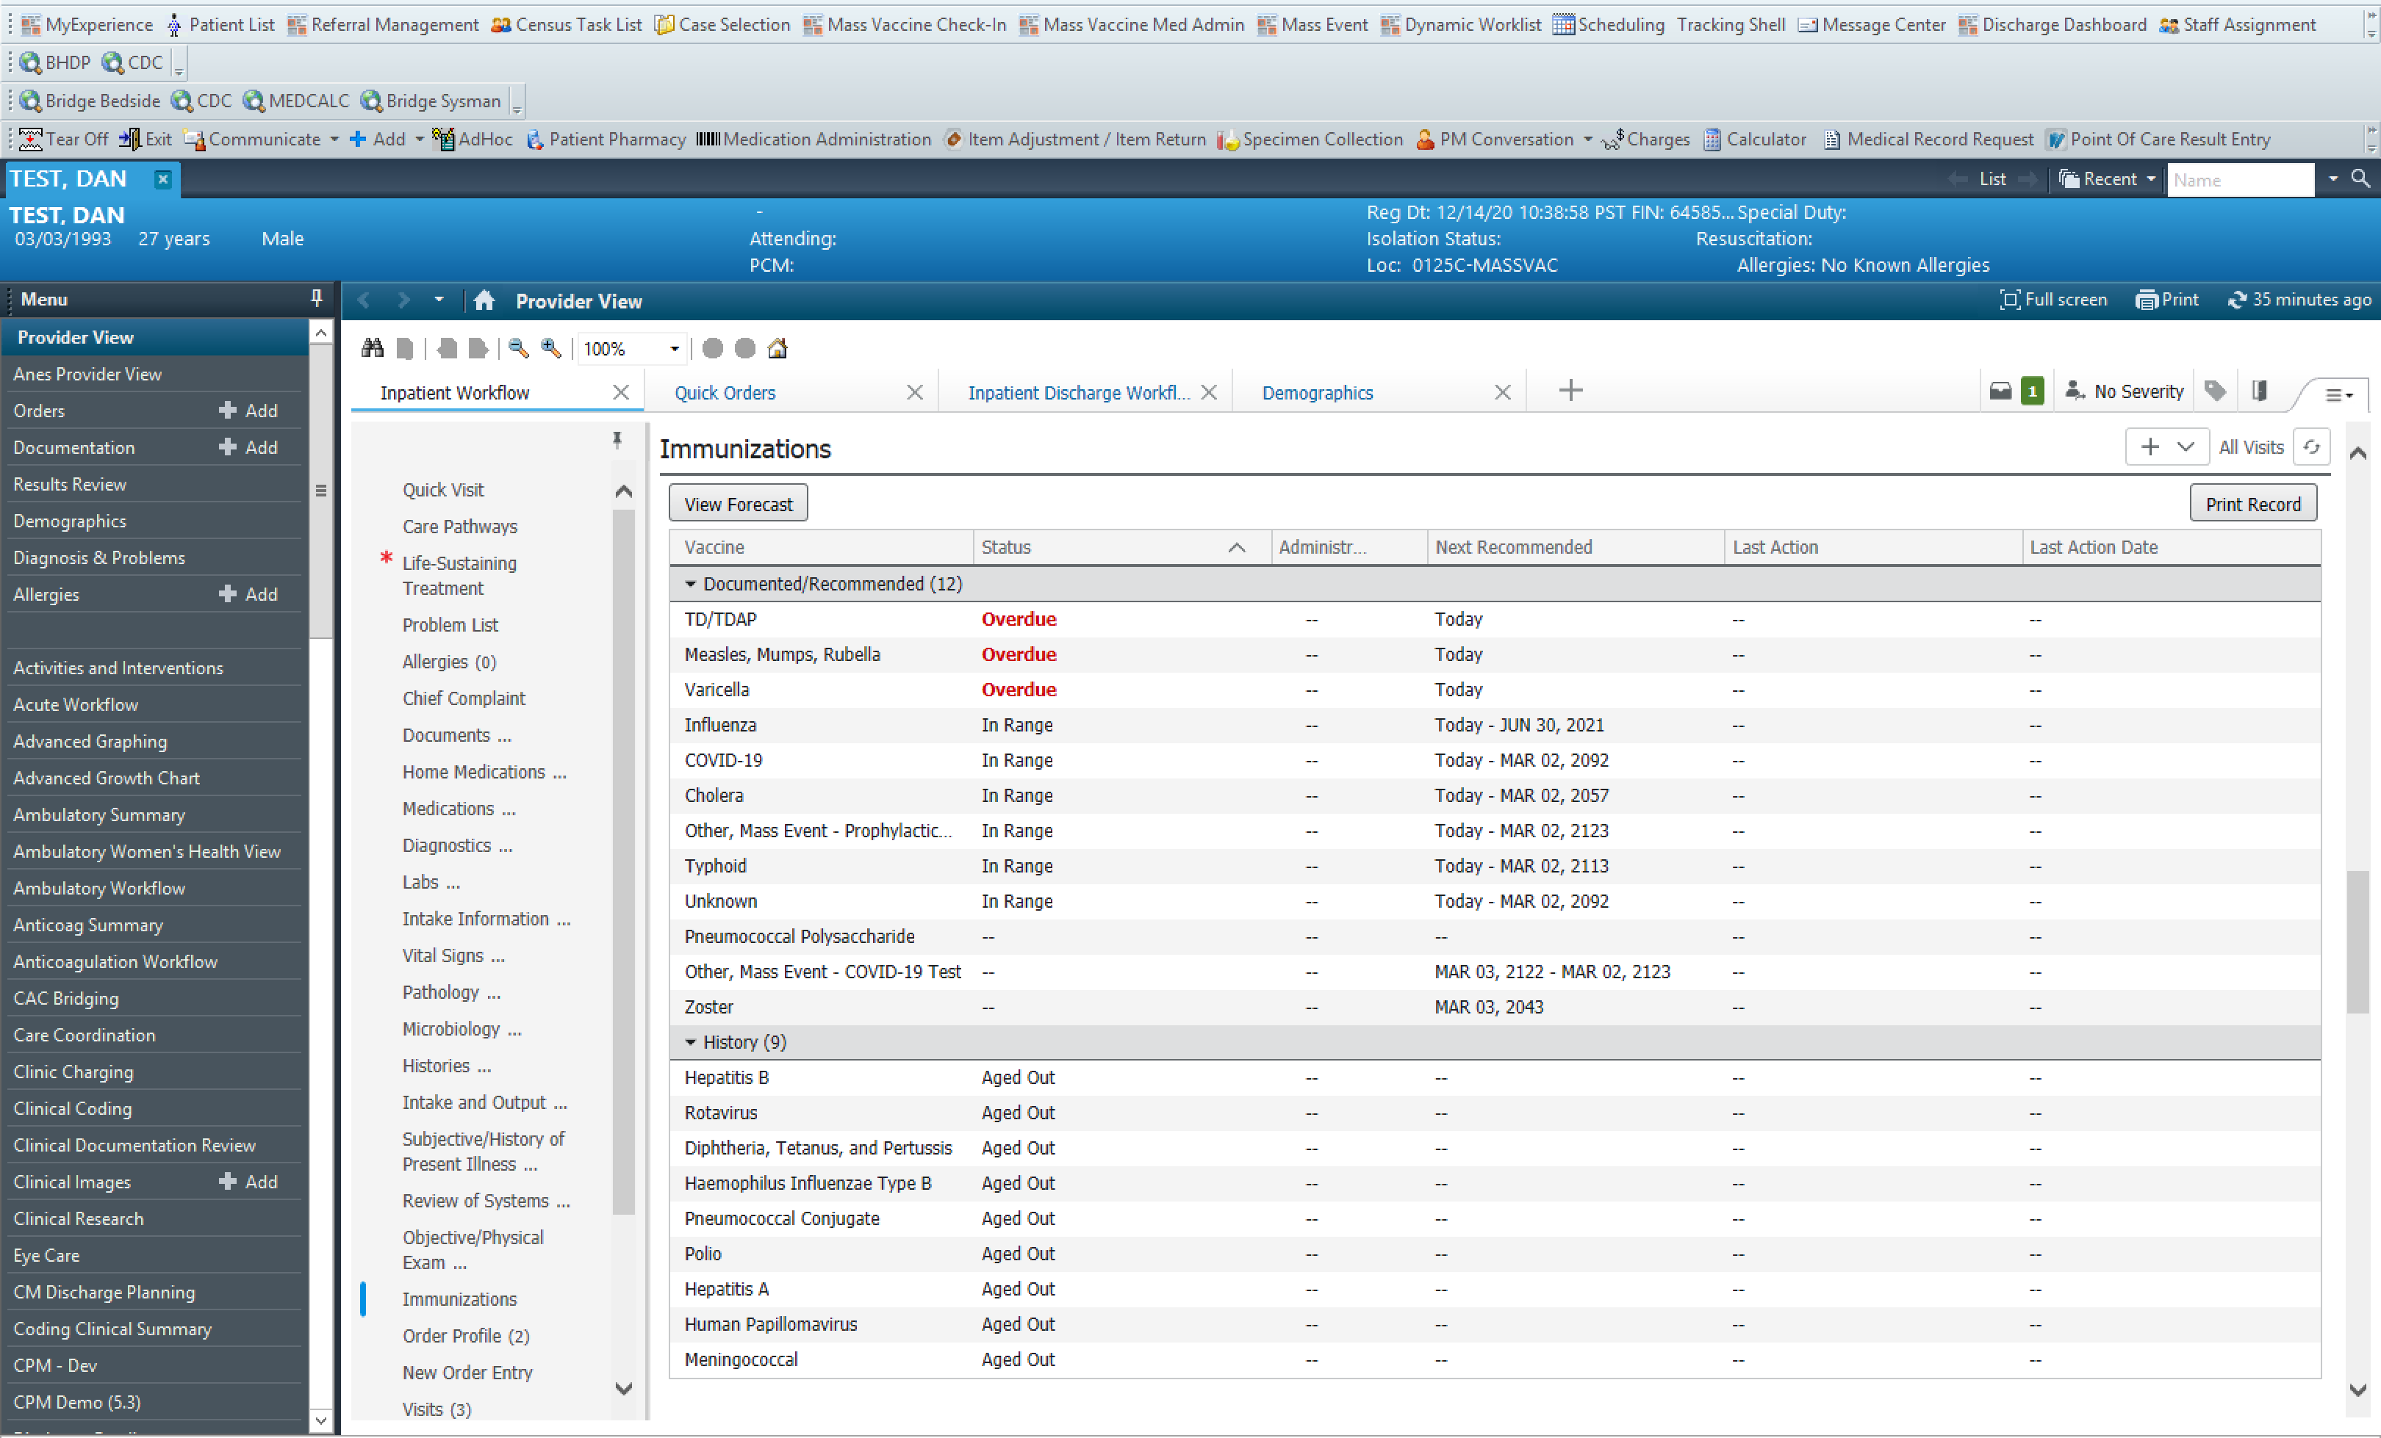
1.

Slide 31
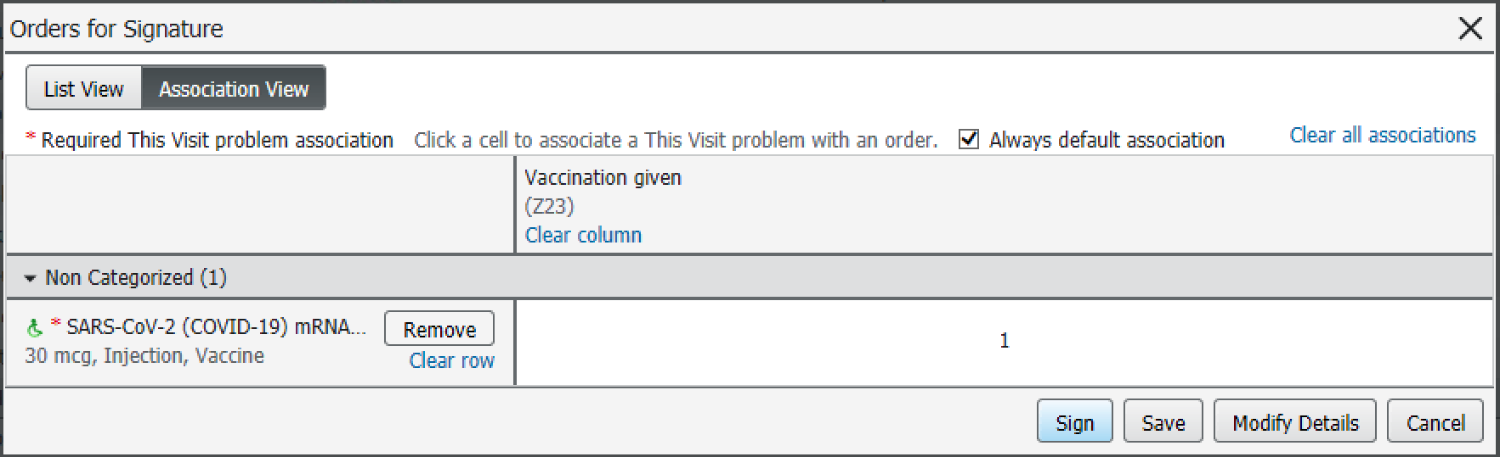
Associate the Diagnosis
1.
1.
Associate the Z-23 Diagnosis if needed
Sign Order

Slide 32
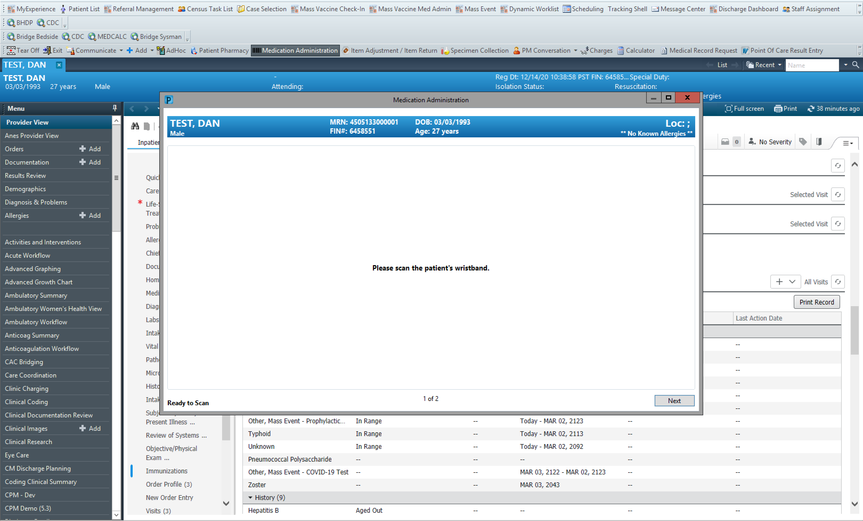
1.
Select Medication Administration
Scan Patient Sheet
2.

Slide 33
BCMA
1.
1. Scan Product Barcode

Slide 34
BCMA - MDV
These are being distributed as Multi-Dose Vials (MDV). What you scan is OVER the amount to be administered – You must tell the system how much you are giving.
1. Acknowledge warning
1.

Slide 35
BCMA - MDV
If more than one lot is loaded in the location’s inventory, the magnifying glass will display which ones are available – Select one.
Update admin dose (30mcg)
Specify Site
OK
If Patient declines at this point, check “Not Given” and provide reasons
1.
Update
2.
3.

Slide 36
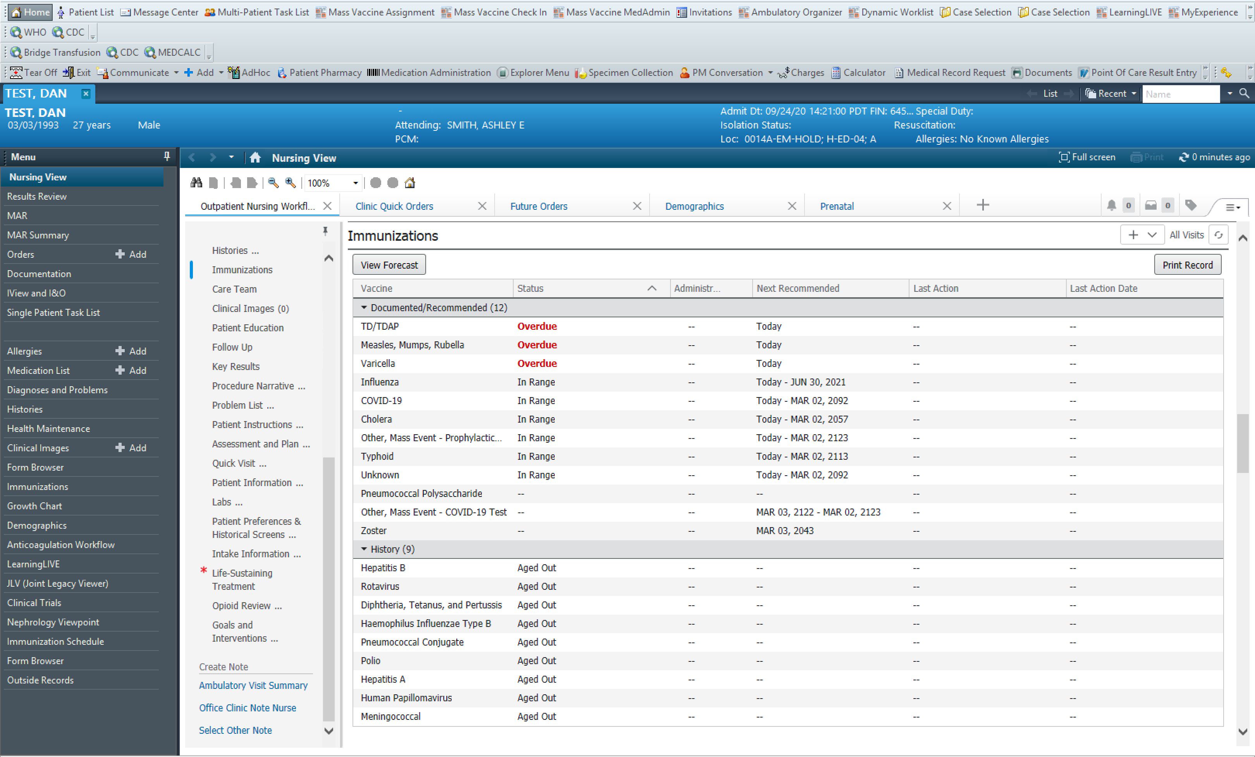
Nurse Visit Note
After administration:
1. Select the “Office Clinic Note Nurse”
Sign & Submit the resulting document
1.

